Slide 1



Slide 2
Cell-Ed Learner Onboarding & Uploading
Training for Providers on May 1, 2024
Notes:
Ngarambe

Slide 3

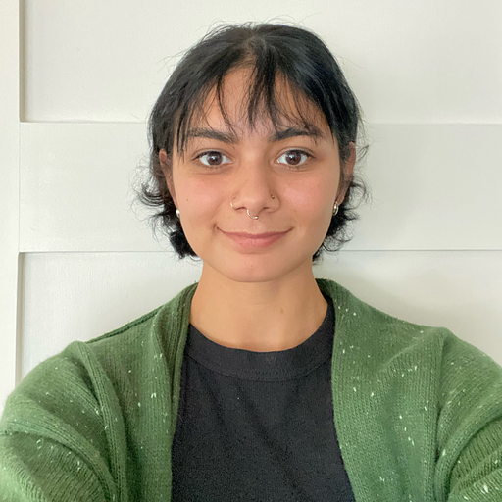
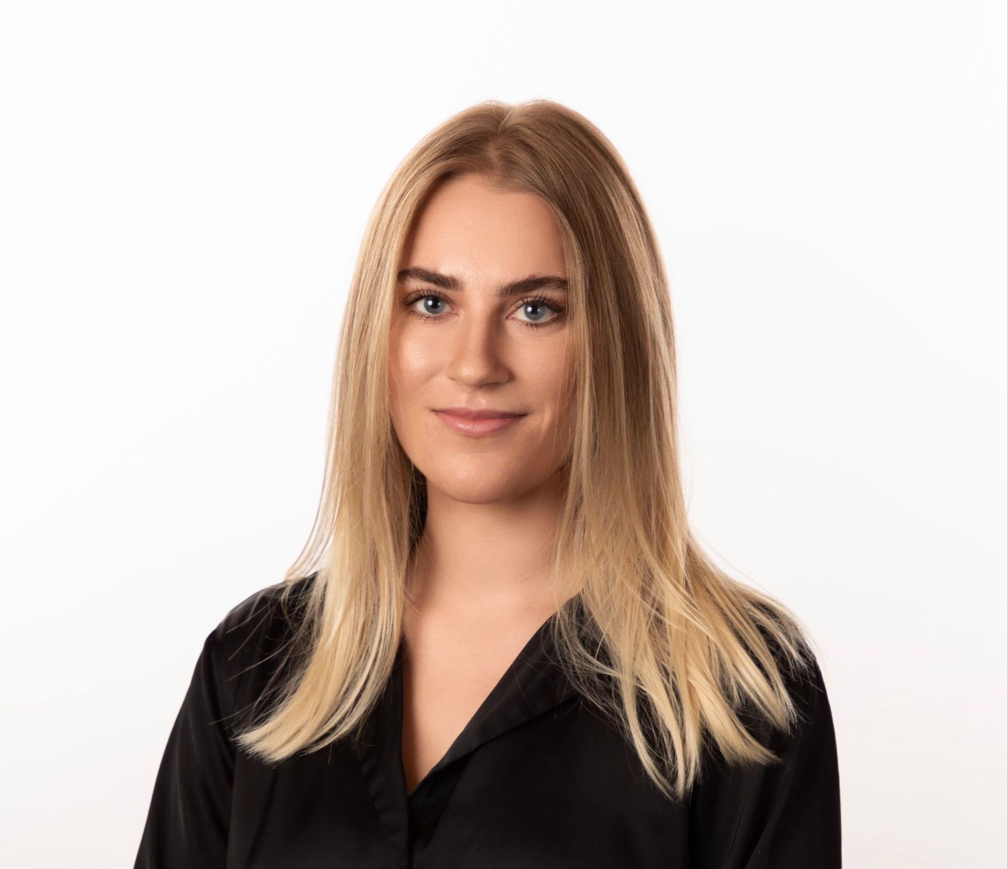
Welcome and Introductions
Ngarambe Jean de Dieu | Customer Success Project Manager
Welcome Start Project Lead
Cloud Navarrete | Outreach & Engagement Specialist
Welcome Start Project Support
Imana Bruner | Customer Success Senior Lead
Welcome Start Project Support
Jennifer Hernandez | Growth & Strategic Partnerships
Welcome Start Project Support
Notes:
Ngarambe

Slide 4
Webinar Guidelines
Click the ‘CC Live Transcript’ link on your Zoom navigation bar for Closed Captioning and ‘Live Transcription’ to add real-time transcription
The webinar recording, slide deck, and transcript will be available on the Toolkit; we will also email all attendees.
Please use the Q&A window to submit your questions. We will answer questions during the Q&A session of the webinar.
Notes:
Ngarambe

Slide 5
Agenda
Introduction
Who is Cell-Ed?
Welcome Start Program
Clients Onboarding Options
Clients Upload Instructions for Providers
Enrollment verification for clients
Sharing Data & Onboarding- FAQs
Questions?
Notes:
Ngarambe

Slide 6
Who is Cell-Ed?
Notes:
Ngarambe

Slide 7
Who is Cell-Ed?
Cell-Ed provides a mobile-first solution proven effective to upskill adults worldwide. Cell-Ed delivers education and live coaching support to individuals who need it most.
No smartphone, internet, or classroom required.
Key features
3-minute Lessons as adults learn better in short, easily digestible bursts.
Coaching Support to provide learners with the encouragement they require.
Proven Effective to deliver 84% faster skills gains and 20%+ higher engagement.
Cross Platform to meet learners where they are - phone, tablet, WhatsApp, laptop.
Notes:
Ngarambe

Slide 8






Key Differentiators
to reach, teach, engage & empower vulnerable populations
designed to reach low literate & resource populations | radically accessible via mobile messaging | engaging audio-lessons relevant & localized, using voice artists | microlearning provides proven gains in fraction of the time | customizable programming data, content, & communications | multi-lingual live coaching support
Notes:
Ngarambe- Cell-Ed is designed to reach low-literate & resource populations through radically-accessible messaging and relevant audio lessons. Micro-lessons allow learner to build on their skills at their own pace. Customizable programing allows our customers to track learner progress and better assess the needs of their community. All learners are supported by our multi-lingual coaches, we have coaches who speak Dari, Pashto, Ukrainian and Russian.

Slide 9
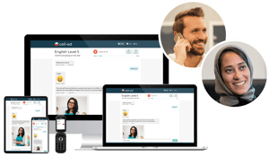
Cell-Ed Coaching
Each learner gets paired with an accredited certified coach who stays with them through their learning journey
Learners are introduced to the system with a warm welcome from their Cell-Ed coach, and lead them through the onboarding process
Learners are paired with their coach based on language ability and needs
Coaches support and encourage learners with their goals
Notes:
Ngarambe

Slide 10
Welcome Start Program
Notes:
Cloud

Slide 11

Program Goals
The Welcome Start program was created to reach eligible refugee populations in the state of California. The program provides culturally-sensitive educational resources to support clients in achieving self-sufficiency and successful integration. Resources include:
English language learning courses
WorkReady courses
Select translated courses available in Dari, Pashto, Ukrainian, and Russian
Live coaches who provide support and encouragement
Learner onboarding materials
Notes:
Cloud

Slide 12

Who is Eligible?
Participants must be eligible Ukrainian Humanitarian Parolees (including non-Ukrainian habitual residents) or Afghan Humanitarian Parolees, SIV holders, refugees and asylees receiving Refugee Support Services (RSS) benefits from one of the impacted counties* service providers.
Citizens and nationals of Afghanistan for whom refugee and entrant assistance activities are authorized (e.g., Special Immigrant Visa holders, Special Immigrants with Conditional Permanent Resident status, SI/SQ parolees, refugees, asylees), whose eligibility date is on or after July 31, 2021.
*Alameda, Los Angeles, Orange, Sacramento, San Diego, San Francisco, Santa Clara, and Stanislaus
Notes:
Cloud - in the future Welcome Start will become open to additional counties, however, refugees will still need to be eligible based on eligibility criteria listed.

Slide 13
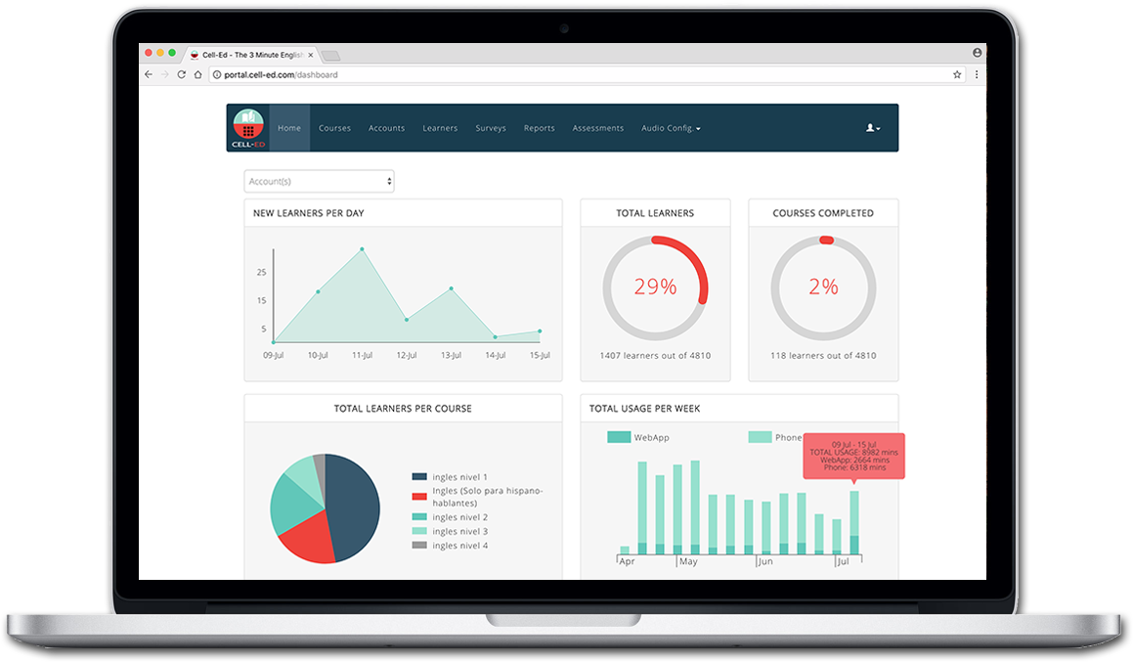

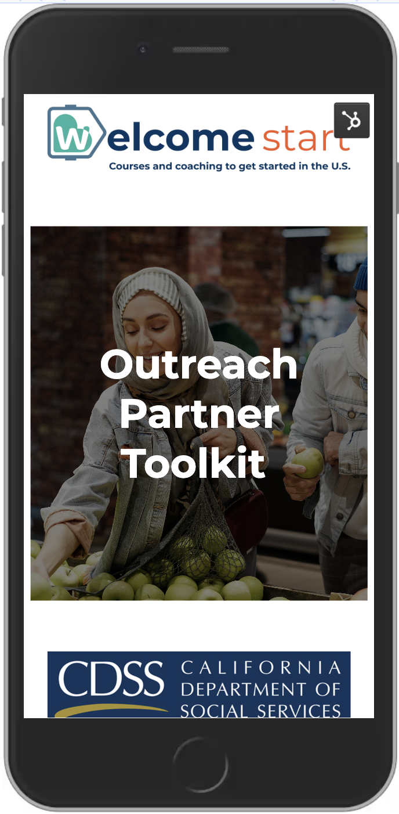

Getting Started: The Welcome Start Toolkit
The Welcome Start Toolkit is home to the materials you need to get started, including:
Information on the program & Cell-Ed
Resources to train new staff
Tools to support clients
Resources for County and provider staff
Register for Toolkit access here.
Once you've registered, you'll see the password and the URL to access the Toolkit.
Please ensure that you do not share the password with individuals outside of your program, these materials are customized for the Refugee Program Bureau
Notes:
Cloud

Slide 14


Client Flyers and Posters
Staff will have access to Client Flyers that guide a learner on how to get started on Cell-Ed
These flyers can help ensure a learner is placed into the course and topic that is right for them
Flyers can be downloaded, shared, or printed to fit the needs of your client population
Flyers and posters can be requested and shipped to the County or Provider Organizations
Notes:
Cloud - Flyers are high printable quality and can be ordered in bulk (25 units)

Slide 15
Client Onboarding Options
Notes:
Imana

Slide 16
Onboarding Options
Client Self-Onboard
  Clients can onboard via the mobile app, WhatsApp, Call-in or Cell-Ed Website. Information is available on the flyer.
  During the onboarding questions, they will have to select the county they live in. This determines which county they are placed in.
Client Bulk Upload
  Each provider can fill out a spreadsheet with their clients’ demographic information (first & last name, dob, zip code, A-Number, etc.)
  Cell-Ed will bulk upload all listed clients to the corresponding county
Notes:
Imana

Slide 17
Bulk Upload Benefits
NOTE: For providers to qualify for client uploads, they will have to be aware of which clients should be studying with Cell-Ed. This may not be the best option for all providers!
Providers can document all clients who are eligible to participate in Cell-Ed Welcome Start
Clients will not have to answer onboarding questions when starting with Cell-Ed
Clients will be connected to the correct provider
It helps alleviate any data quality issues
It removes the burden on the client to onboard
Notes:
Imana

Slide 18
Clients Upload Instructions for Provider
Notes:
Imana

Slide 19
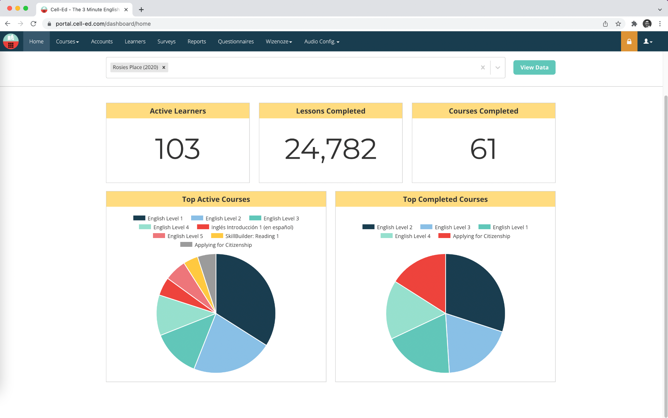
Client Upload: Step 1
Contact the Cell-Ed team to begin your client upload process at california@cell-ed.com, sign the Memorandum of Understanding regarding data sharing and return the form to Cell-Ed
Notes:
Imana / Jennifer

Slide 20
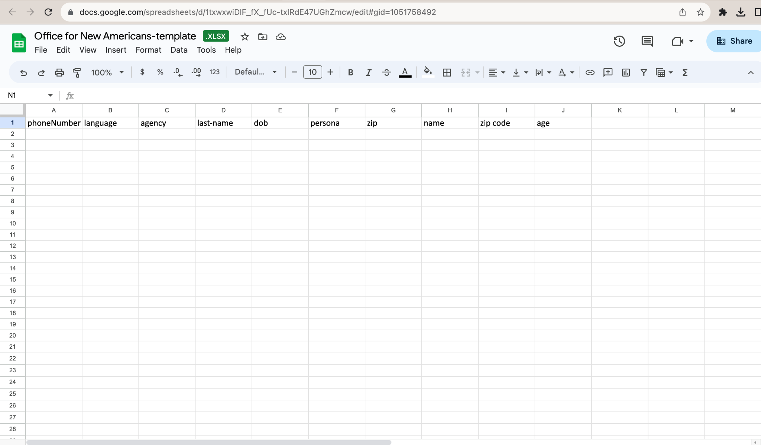
Client Upload: Step 2
Check your email for a Welcome Start Client Data form.
  After receiving a signed MOU, Cell-Ed will ask whether you prefer to use a secure DropBox or Google folder to share your client data.
Cell-Ed will email you a link to your organization’s secure folder and data upload form. Here is a sample template to see what information will be requested.
Notes:
Imana

Slide 21
Client Upload: Step 3
Cell-Ed will create a new folder in either Google Drive or Dropbox.
The folder will contain the Welcome Start Client Data form and will only
be shared with approved staff.
Please be mindful of who has access to this shared folder and who is accessing client data.
Notes:
Imana

Slide 22
Client Upload: Step 4
Identify clients who should be associated with your account on Cell-Ed
Gather demographic information from your clients
Update your Client Data form with your list of eligible clients, please ensure that all data is entered in the secure folder
  Important Note: Please do not send client’s personal identifying information through email
without it being protected.
Notes:
Imana

Slide 23
Enrollment verification for Clients
Notes:
Jennifer

Slide 24
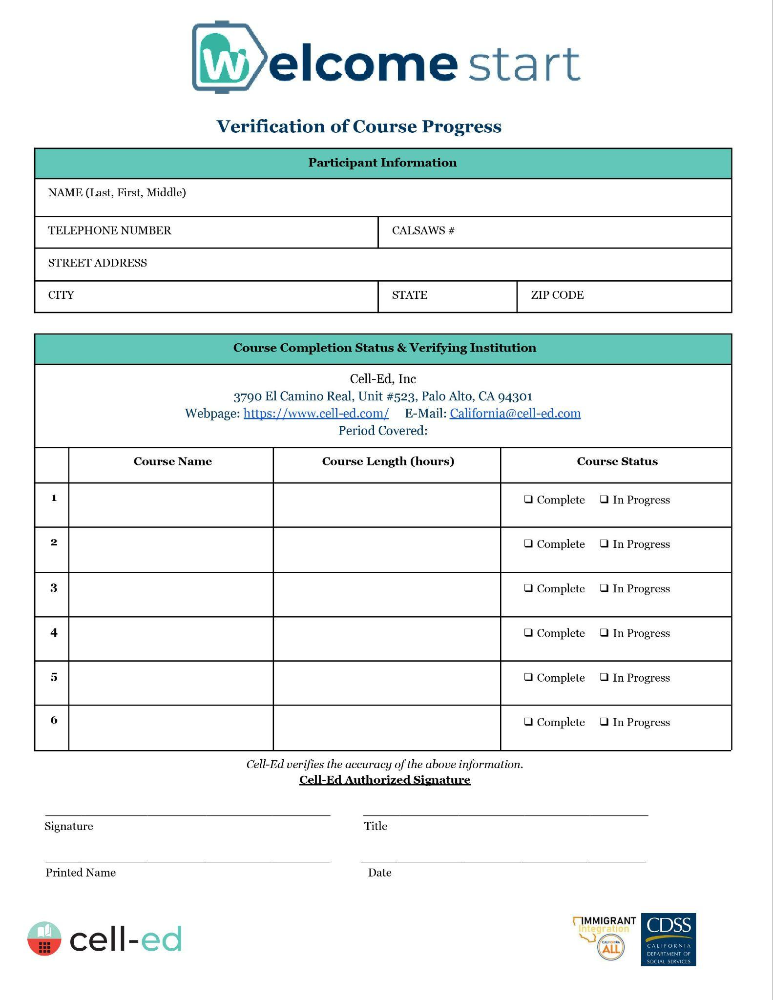
Supporting Clients show Proof of Enrollment
Goal: Provide clients with a document that certifies which courses they have taken, and number of hours for a given time period.
Client Information:
Name
Telephone
Address
CalSAWS# (will be blank)
Cell-Ed Information:
Contact information
Courses- name, length (hrs/mins)
Signature
Notes:
Jennifer

Slide 25
Sharing Data & Onboarding- FAQs
Notes:
Jennifer

Slide 26
Sharing Data
What type of MOU would a provider need to provide?
Use the MOU Template provided. If your organization already has an MOU that has been approved by your legal counsel, Cell-Ed would be happy to use your version as a starting point.
As a County RSS provider, do we need a provider MOU?
If your organization would like to share your data directly with Cell-Ed so your clients are uploaded directly onto the system a MOU is required. Sharing data helps alleviate any data quality issues by having the information coming directly from the provider and makes it easier for clients to get started with courses.
Notice: Your organization would NOT need an MOU if your clients sign on to Cell-Ed using the flier or website.
Notes:
Jennifer

Slide 27
Sharing Data
Why is data being collected such as an A-Number?
Welcome Start is funded by the U.S. Office of Refugee Resettlement (ORR). Therefore, Cell-Ed is required to collect certain data by the State of California for funding and reporting purposes.
Is my client’s data secure?
Yes. Cell-Ed takes data security very seriously. Cell-Ed is accountable to all State and Federal laws. Cell-Ed is SOC-2 certified and HIPAA compliant ensuring the company maintains the highest data security standards.
Notes:
Jennifer

Slide 28
Client Onboarding
Are there different options for onboarding clients?
Option 1: For clients for whom a provider has shared client information via the sharing data process, clients will be able to bypass onboarding questions when they sign up.
Option 2: Clients whose data has not been provided to Cell-Ed must register themselves
and answer a series of questions, including phone number, date of birth, A-Number.
How can I support clients reluctant to submit information such as an A-Number?
We understand that clients may be hesitant to share personal information. Reassure clients, Cell-Ed will not use Client information beyond the scope of the Welcome Start program. The reason for requesting the A-Number is solely for reporting purposes. Cell-Ed is committed to maintaining the highest level of security for your client’s data.
Notes:
Jennifer

Slide 29
Additional Information
You can update and add new clients to the list weekly
Client information will be uploaded to Cell-Ed’s secure, encrypted Customer Portal
Clients will still need to login to Cell-Ed to begin courses
○ Share the website or flyer (found in the toolkit) to help them get started
If you have any questions or need to make alterations to your data, please reach out to the Cell-Ed team at: california@cell-ed.com
Notes:
Jennifer

Slide 30
Questions?
E-mail us at: California@cell-ed.com
Notes:
Ngarambe

Slide 31
Thank you!
Notes:
Ngarambe

